Slide 1





Slide 2

The purpose of this project is to develop vehicle accident prevention by method of alcohol detector in an effort to reduce traffic accident cases based on driving under the influence alcohol
This type of system is a great safety factor which can be implanted in the steering
of the car.
When driver start the ignition system, sensor measures the concentration of alcohol in to its breath and switch off the ignition system

Slide 3

. MQ-3 ALCOHOL SENSOR
6v-12b BUZZER
On/off SWITCH
POTENTIOMETER
RELAY MODULE
DC MOTOR
BUZZER
CAPACITANCE

Slide 4

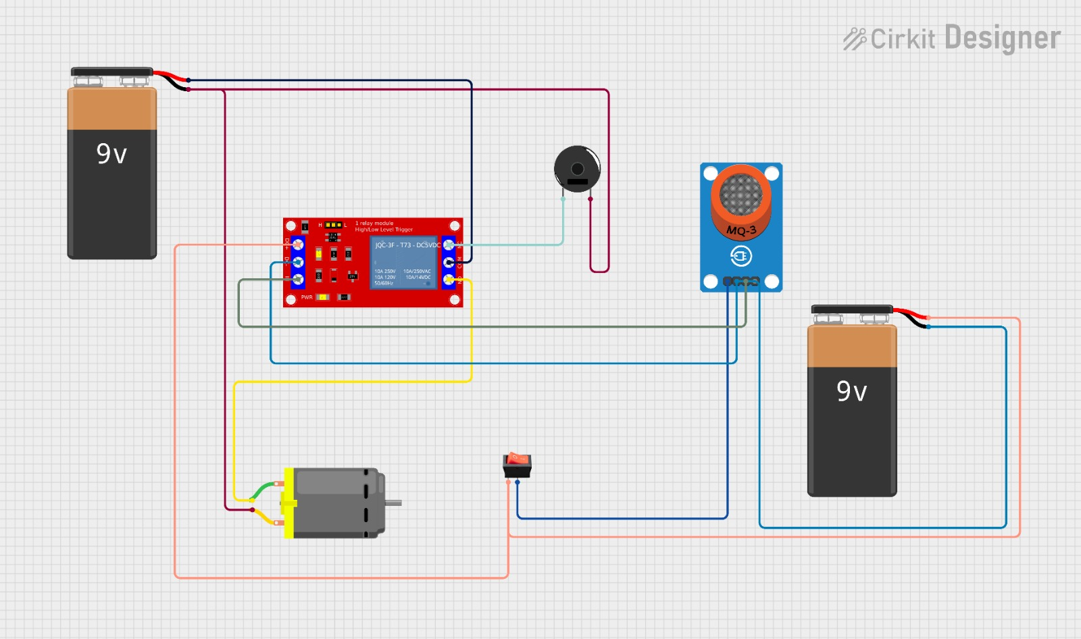

Slide 5


When a driver enters the vehicle and attempts to start the engine, the real-time alcohol detection system is activated.
If the alcohol level detected is within legal limits, the engine is allowed to start, and the vehicle can be operated as usual.
However, if the alcohol level exceeds the legal limit or if alcohol is detected in the
driver's system, the auto cut-off engine system is triggered.
The driver is then notified of the alcohol detection, and the vehicle remains immobilized until it is safe for operation.

Slide 6


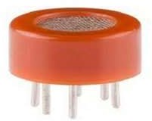
Technically referred to as an MQ3 sensor, the alcohol sensor finds ethanol in the air.
When a drunk individual breaths close to an alcohol sensor, the sensor detects the ethanol in his breath and outputs information dependent on the amount of alcohol in his breath. More LEDs would light up if the alcohol percentage was higher.
It is capable of detecting 25-500ppm alcohol gas
concentration in the air.

Slide 7

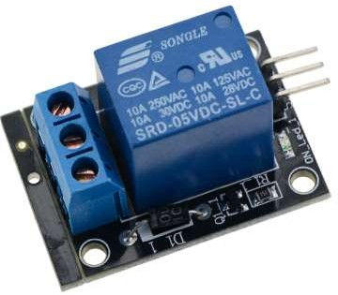
The primary function of a relay module is to act as a switch for controlling the flow of electricity to a load.
This capability allows relay modules to isolate the control circuit from the high-power load circuit, providing a safe and efficient means of controlling various devices.
Relay modules come in different configurations, such as single-pole single-throw (SPST), single-pole double-throw (SPDT),
Double-pole single-throw (DPST), and double-pole double- throw (DPDT), each suited for specific applications based on their switching capabilities.

Slide 8

It is available at cheaper price.
It has long life cycle.
It offers high stability.
It has high sensitivity which results into faster response time.
Alcohol sensor based car protects you when you are drunk. During such condition, your other family member can drive

Slide 9

Applications of Automatic Engine Locking System Through Alcohol Detection can be used anywhere to reduce the probability of road accidents.
“Automatic Engine Locking System Through Alcohol Detection project” can be used in various vehicles for detecting whether the driver has consumed alcohol or not.
It also be used in ac cars while the alcohol smell is detected the Ac while will turn OFF including with the iginition system

Slide 10

Finally This device provides much advanced facilities in now a days life as it can be easily implemented in vehicles. Thus we can reduce alcohol and drowsy related road accidents and hence these kinds of detectors have a great relevance.
‘’DON’T DRINK AND DRIVE”

Slide 11


